Slide 1
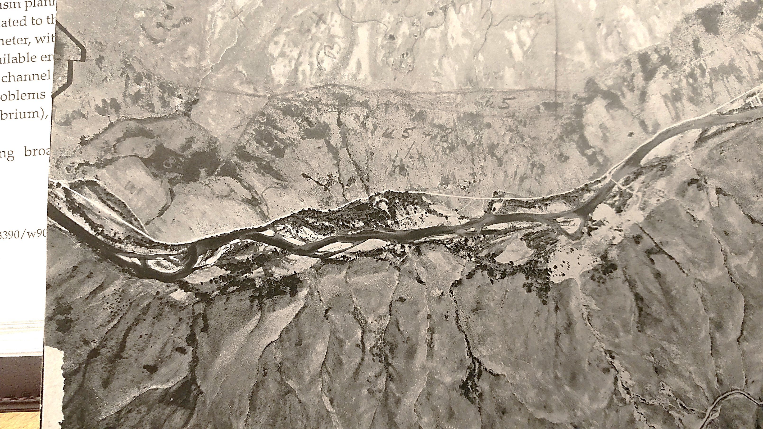
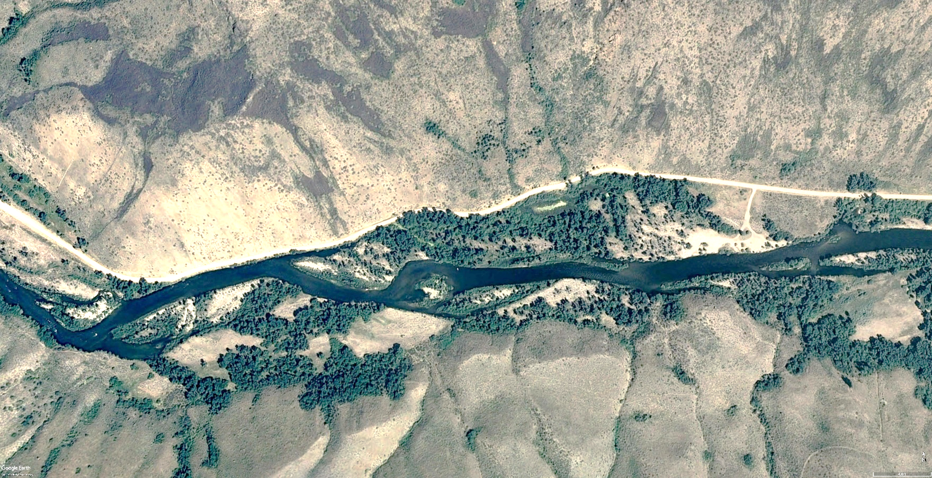



1957 – 391 cfs
2009 – 406 cfs
Identifying restoration priorities for native aquatic and riparian species within the river corridor
Andy Tranmer, Daniele Tonina, Rohan Benjankar, Dmitri Vidergar
Center for Ecohydraulics Research
University of Idaho
October 19, 2023
Notes:
If you can see this screen I am showing you the wrong one!

Slide 2
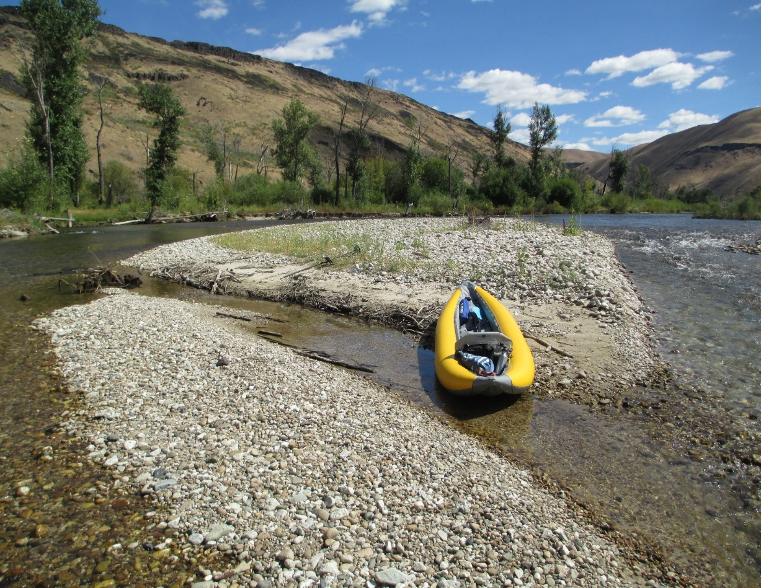
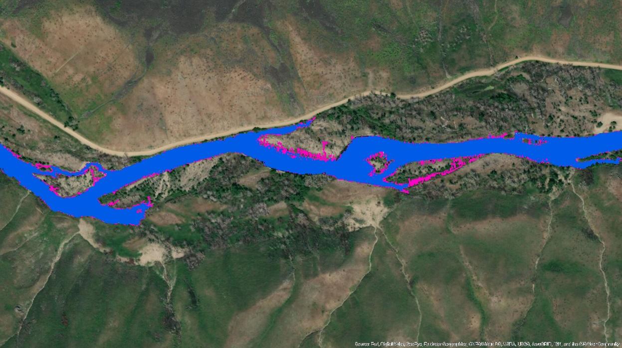
SFBR river corridor
Semi-arid climate
Semi-confined canyon (limited floodplains)
Multi-thread river w/islands (formerly bars)
Main channel and side channels
Coldwater dam releases
Average Years
Irrigation Flow (blue) – 1,600 cfs
Peak Flow (magenta) – 2,500 cfs

Slide 3
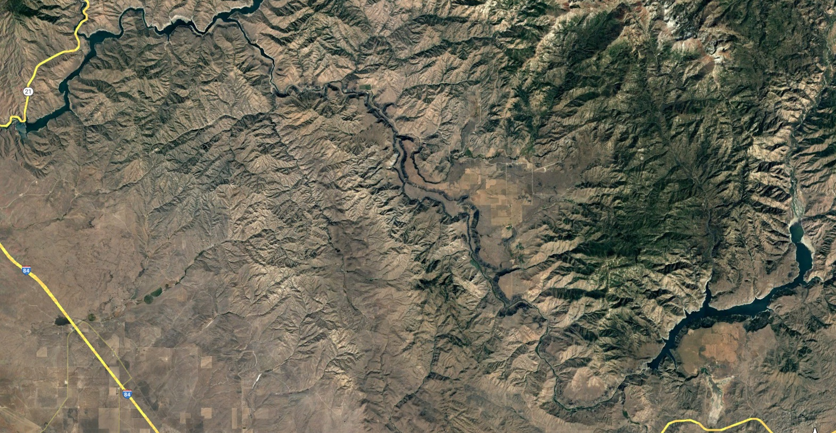
Lots of scientific research on the SFBR
Arrowrock and Lucky
Peak Reservoirs
Anderson Ranch
Reservoir
Anderson to Arrowrock = 45 km (28 mi)

Slide 4
Recent research on the SFBR
USBR Bull trout monitoring
Post-wildfire riparian forest recovery
Basin-scale hydrology model
Snow model
Hydrologic model
1D numerical models
hydraulics
sediment transport
temperature
2D numerical models
hydraulics
rearing habitat for juvenile bull trout
rearing habitat for rainbows (unpublished)
riparian vegetation

Slide 5
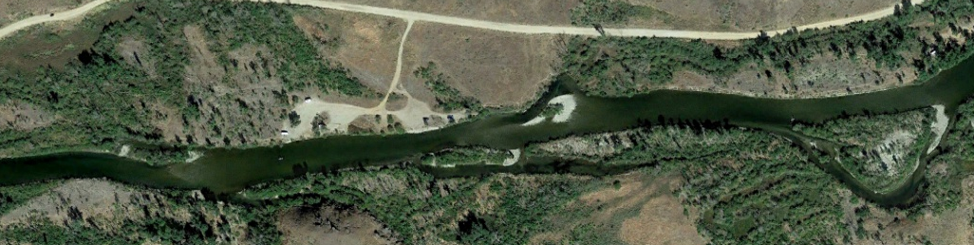
Aquatic habitat suitability modeling
Aquatic habitat suitability ranges from 1 (blue = excellent) to 0 (red = bad)
Stars show tagged BT use of excellent habitat
Location: Downstream
Reclamation Village
Baseflow = 300 cfs

Slide 6
Main channel, lateral, and total juvenile habitat
Habitat depends on streamflow
Weighted useable area (WUA)
Habitat suitability index (HSI)
Decreases in main channel during irrigation flows (1,600 cfs) and above
Increases in lateral channels at higher flows
Restore side channels to increase summer rearing habitat
Potential for overwintering habitat
300 cfs
1600 cfs
Benjankar et al., 2018b

Slide 7
Summer water temperatures
River temperature depends on reservoir level.
  Lower elevation = warmer temperatures
Reservoir maintains cool water downstream relative to undammed case.
Benjankar et al., 2018a

Slide 8
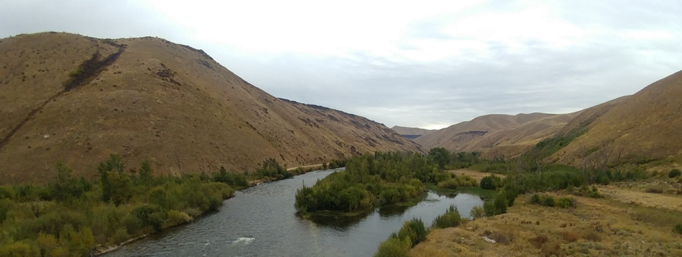
Riparian forest modeling
23 km downstream Anderson Ranch Dam
Average hydrologic year (2016) - 1.25 year R.I.
Wet hydrologic year (2017) - 50 year R.I.
Average year restoration planting
Riparian forest conditions, SF Boise River

Slide 9
Average year
Wet year
Restoration planting
Sites
Cow Creek
D/S Danskin Bridge
D/S Reclamation Village
Cow Creek
Danskin Bridge
Reclamation Village

Slide 10
Modeling 23 km of recruitment in SF Boise River
>99% seedling failure during average years (1.25-year R.I. -2016)
93% failure during wet years (50-year R.I. - 2017) (Benjankar et al., 2020)
What mechanisms led to such poor recruitment?
  Improper peak flow timing
  Low floodplain-channel connectivity
  Insufficient physical disturbance (shear stress)
  Too-fast recession rate
  Baseflow too low to support vegetation
Notes:
Previously we lacked the tools to address these critical management questions.
Recoded our recruitment model to specifically output the failure mechanisms.

Slide 11
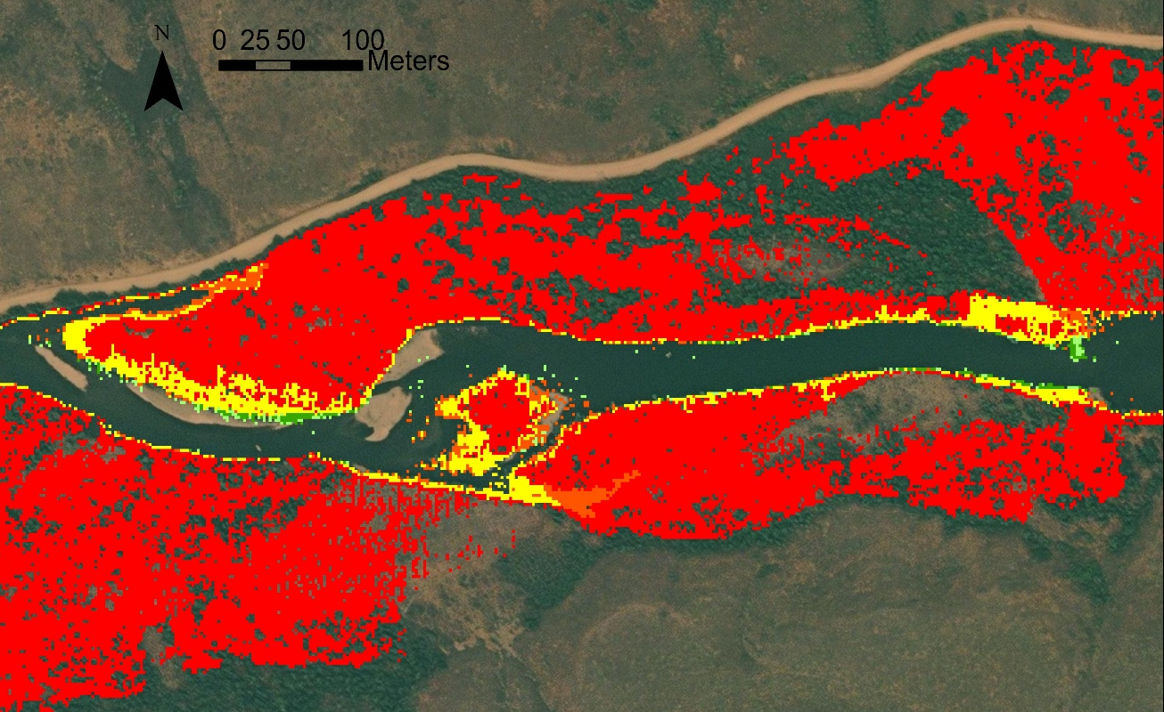
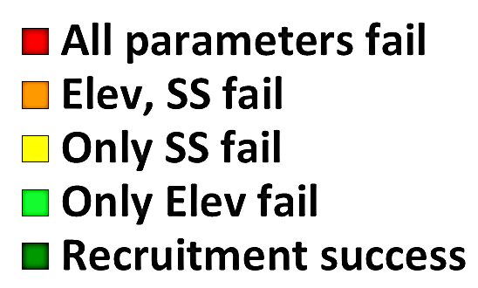
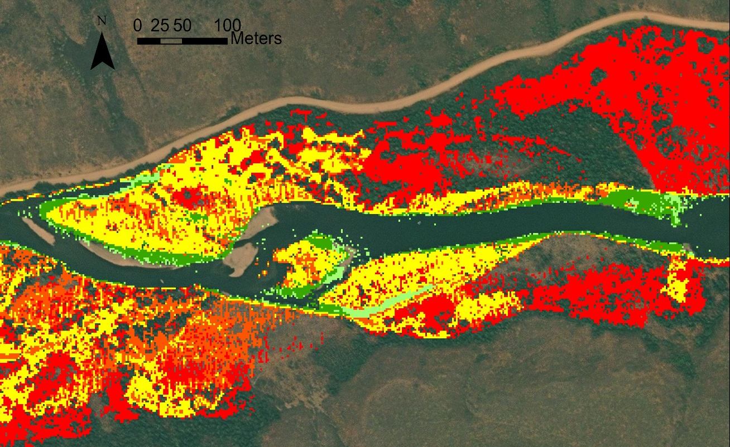
Failure Maps
Floodplain area in 1 km reach ~140,000 m²
Average year
90% of floodplain fails all parameters (red area)
9% of floodplain is available for restoration (yellow and orange areas)
0.5% of floodplain has recruitment success (dark green area)
Wet year
45% of floodplain fails all parameters (red area)
49% of floodplain (~68,000 m²) is available for restoration (yellow and orange areas)
6% of floodplain has recruitment success (dark green area)
Ave Year
Wet Year

Slide 12
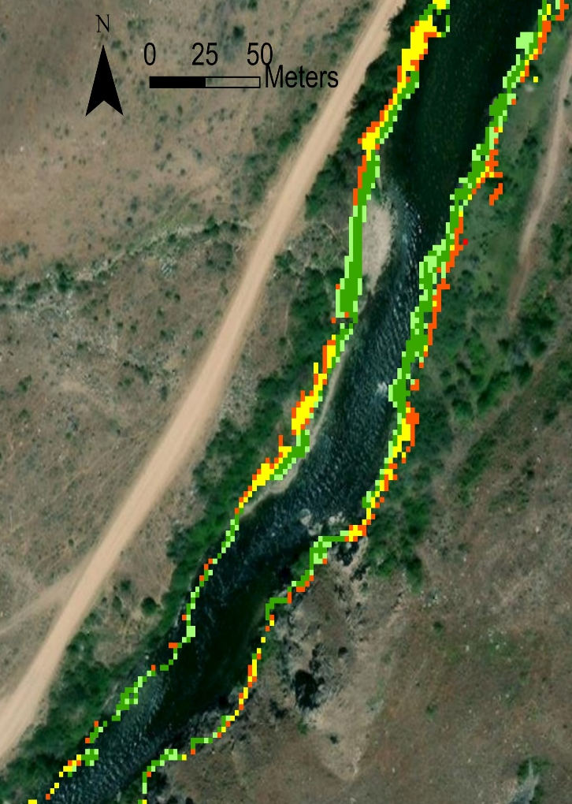
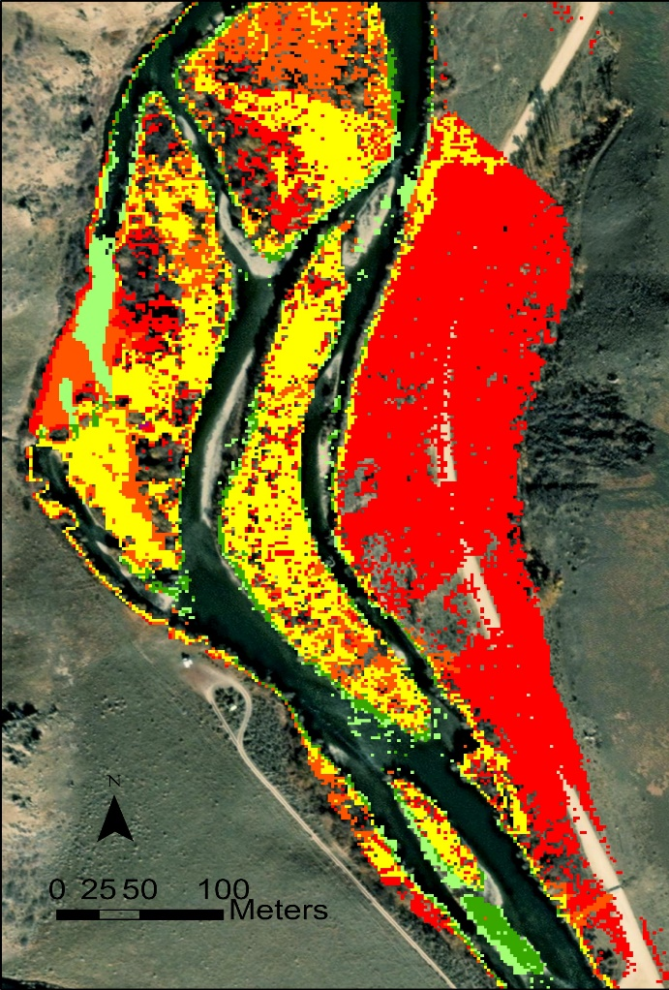
Spatial Maps To Inform Decision Making
Identify areas of passive riparian regeneration and potential restoration
Optimize floodplain-scale restoration
Manual disturbance (yellow)
Deep planting vs. increase baseflow (orange)
Floodplain reconstruction (red)
Plan restoration for hydrologic year
Have scalable plans for available water years
Prioritize watershed-scale restoration
Compare different floodplains in watershed for greatest return
Restore low-hanging fruit first
Wet Year
Wet Year
Notes:
Ultimately, the model outputs spatially continuous information that provides four key benefits
Do not grub the whole FP, but can target certain areas with different strategies.
Map of the physical processes that you can show to riparian ecologists to debate the best restoration approach.
Then, hand the map with GPS coordinates to a contractor to perform the work.

Slide 13
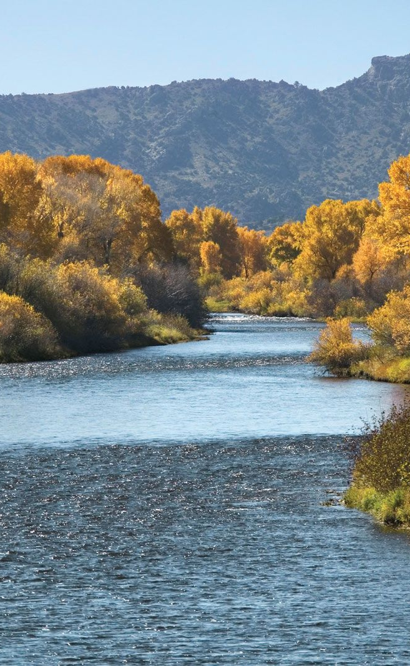
Potential next steps…
Establish river dependence on climate change and resultant reservoir conditions
3D model reservoir water quality (temp, nutrients, etc.)
Evaluate climate scenarios impact on reservoir + river habitat
Quantify forest biomass on the floodplain
Estimate floodplain carbon volume
Evaluate forest habitat availability
Assess long-term forest trajectory
Understand summer flow pulses on riparian vegetation survival
Water table responds rapidly to streamflow
Can short flow pulses (~1 day) support late-season seedlings?
Notes:
For those of you with more money than you know what to do with, we would like to expand our model capacity.

Slide 14
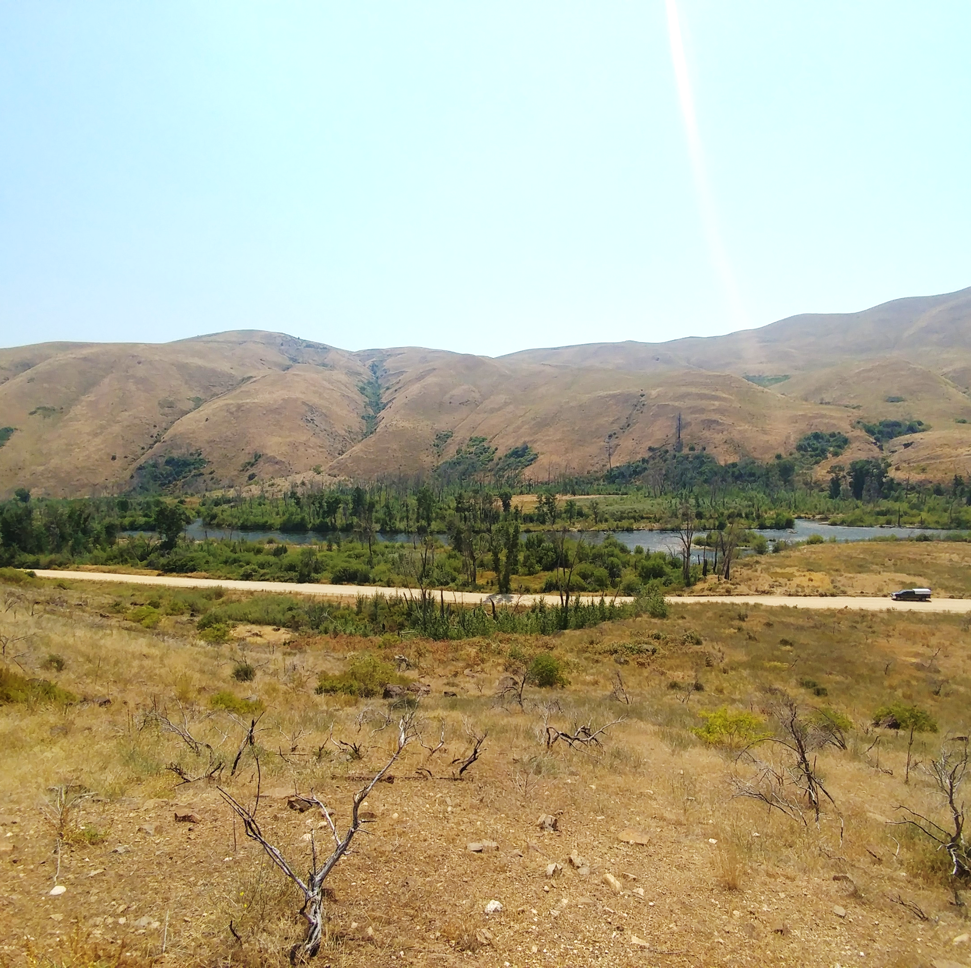
Questions?
Feel free to email me with questions: andyt@uidaho.edu

Slide 15
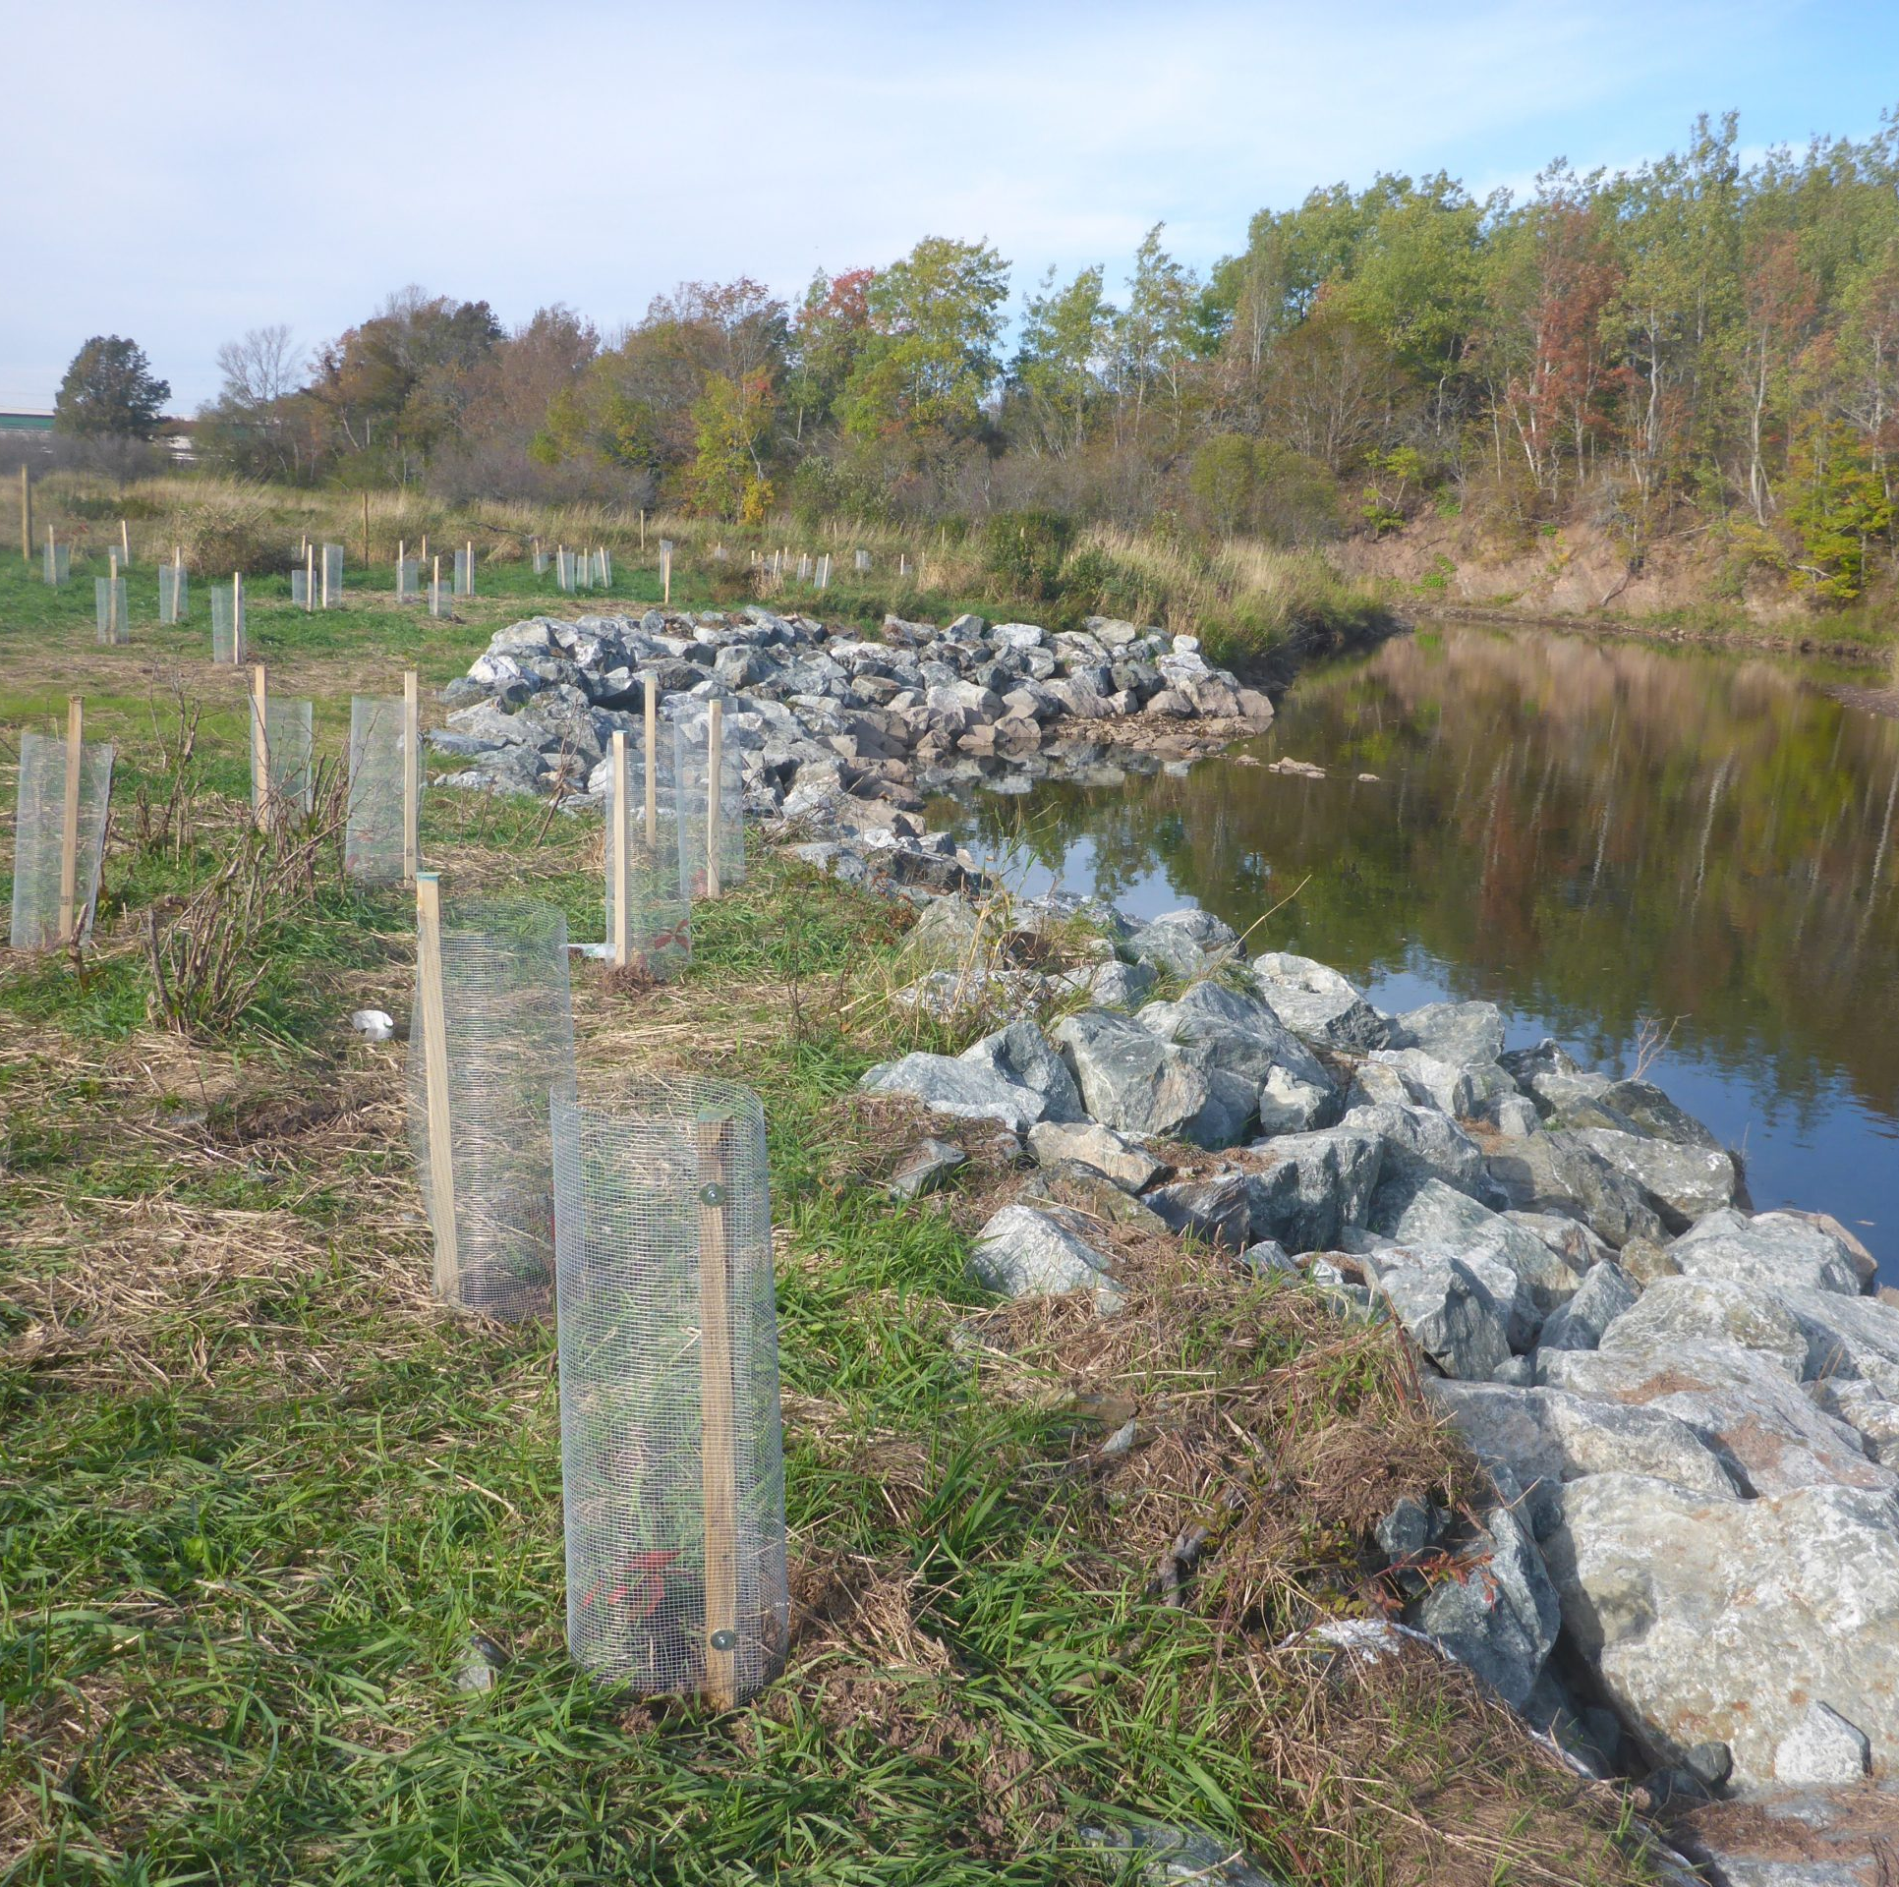
Restoring Native Riparian Forests
Riparian restoration is increasingly common
  Manual plantings are labor intensive
  Occur over small areas
  Expensive (labor and plants)
  High failure rates (~40-80%)
This approach is not feasible over large spatial scales (10-1,000 km²)?
  Much more efficient to work with natural processes
  Maintain genetic diversity (sexual reproduction vs. clonal cuttings)

Slide 16
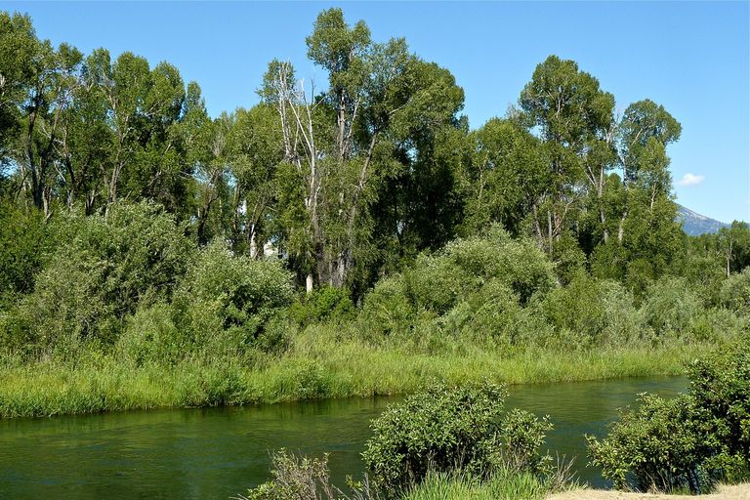
U.S. forests face many challenges
Common problems include:
Drought
Wildfire
Invasive species
Pests/recreational users
Native riparian forests face additional challenges:
Mega floods (e.g., floodplain stripping events)
Cattle grazing
Dams and flow regulation
Conversion to upland communities

Slide 17
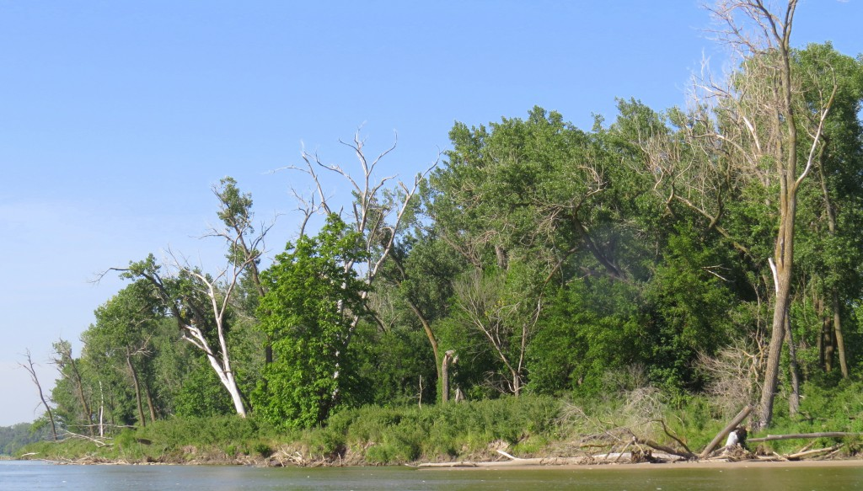
Riparian forests from Missouri to California see reduced regeneration of pioneer forest species below dams (Braatne et al., 2007; Burke et al., 2009; Dixon et al., 2015)
Processes interrupted…
Many dams built in 1940-1950s
Reduced floods and cutoff sediment supplies
Limited sexual reproduction
Cottonwood expected lifespan is ~150 years
Average age of forests 80+ years old
Managers stuck in the middle
Lack of flood capabilities
Creatively regenerate populations?
Notes:
Downstream of dams, diminished regeneration of pioneer forest species from Missouri to California
This is because dams reduce downstream floods and cutoff sediment supply from basin
From the management side, we need to jumpstart the regen process

Slide 18
Developed a 2D ecohydraulic model to predict cottonwood and willow seedling recruitment (Benjankar et al. 2020)
Seedling recruitment based on hydraulic and physiologic requirements (Mahoney and Rood, 1998):
Seeds release during same time as seasonal flood
Water goes overbank to disseminate seeds (hydrochory)
Physical disturbance to create bare sediment and sunlight
Water recedes at same rate as root growth (~1cm/day)
Floodplain elevation within range of groundwater/baseflow

Slide 19
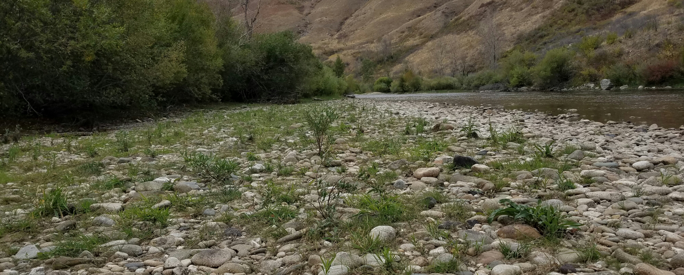
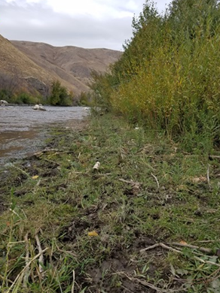
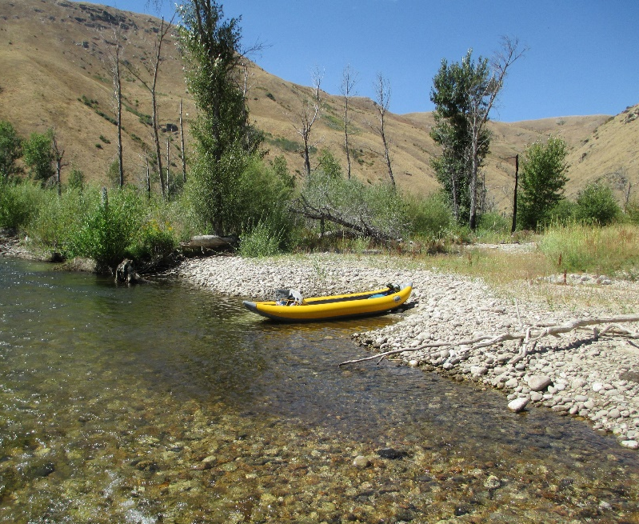
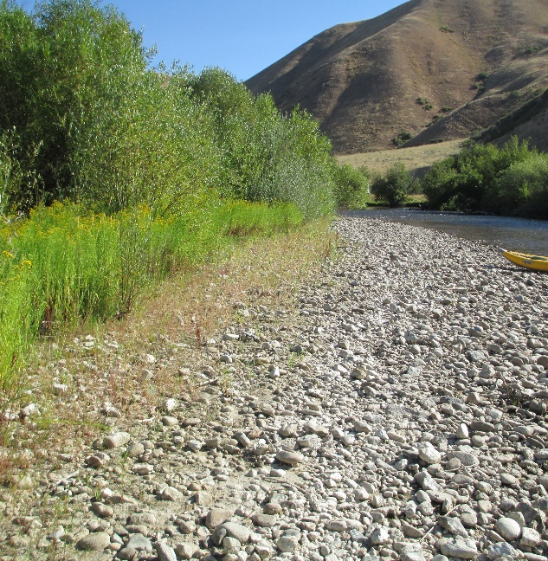
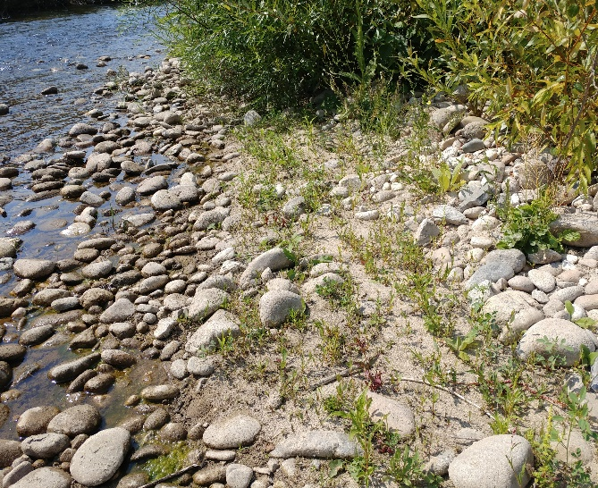
Field surveys in 2016 and 2017

Slide 20
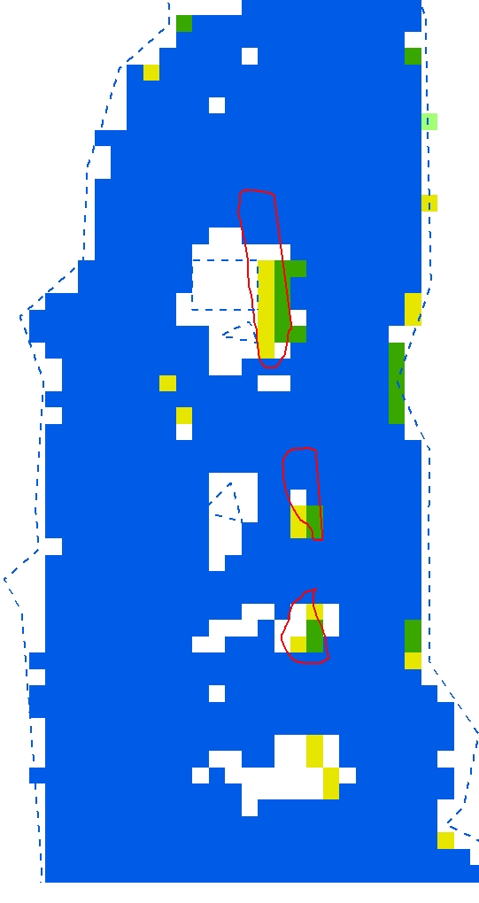
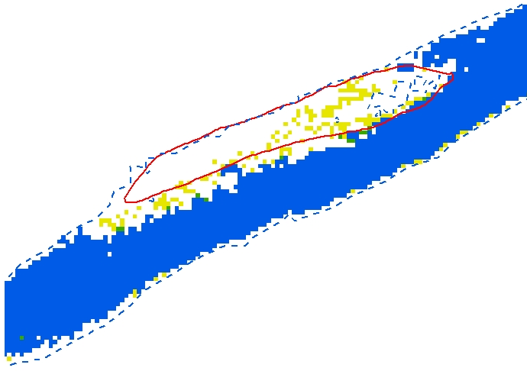


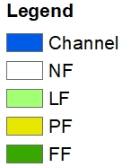
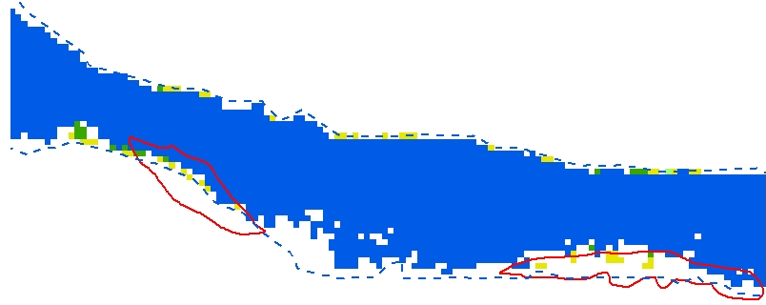
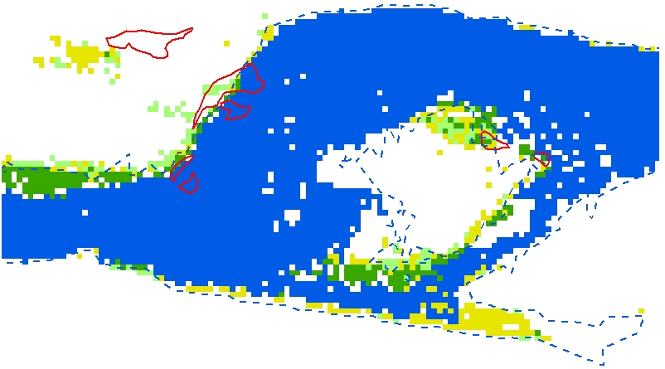

Ecohydraulic model predictions
Field surveys and model comparison
75% successful at identifying seedling regeneration in average year
95% successful in wet year
Slight tendency to overpredict regeneration areas
Nice tool for predicting riparian forest recruitment
Field map 3
Field map 2
Field map 1
Field map 4

Slide 21
Native Riparian Forest Regeneration Model
Identify the problem - Why does native forest regeneration fail?
Spatially constrain the failures - Inform floodplain-scale restoration activities
Quantify floodplain regeneration across the watershed - Prioritize floodplain restoration at the watershed scale (10-1,000 km²)?
Notes:
Use the reconfigured riparian model to

Slide 22
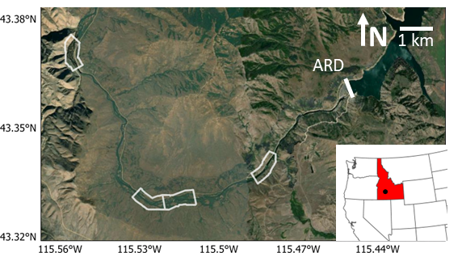
Recruitment mechanisms over varying floodplain widths
Examined four 1 km-long reaches with different floodplain widths
Normalized floodplain width by channel width
  W*_{fp} = W_{floodplain} / W_{channel}
Compared failure mechanisms for:
  Range of floodplain widths
  Under ave and wet hydrologic conditions
Notes:
W*fp is ratio of how wide the floodplain is relative to the channel width
For example, W*fp = 5 means the floodplain is 5 times wider than the average channel width

Slide 23
Recruitment mechanisms over varying floodplain widths
Average years limited by floodplain inundation
  Physical mechanisms had little response to floodplain size (p > 0.05)
  Seedling recruitment was similar across all floodplain sizes (p > 0.05)

Slide 24
Recruitment mechanisms over varying floodplain widths
Wet years inundate >90% of floodplain
  Recruitment mechanisms increase 400-1,600% above average hydrologic year
  Success of all physical mechanisms and seedling recruitment increased with floodplain size (p < 0.05)
  Floodplain width is important during wet years!

Slide 25
Conceptual Riparian Regeneration Model
Increasing
Geomorphic
Disturbance
Riparian
Turnover
Large-scale
Recruitment
Hydrologic Condition
Average Wet
Small-scale
Recruitment
Seedbank
Maintenance
Narrow (W*_{fp} ~1-2) Wide (W*_{fp} > 4)
Relative Floodplain Width
Notes:
We tried to summarize this in a conceptual model.
FP width on the X axis and hydrologic condition on the Y axis
During ave years narrow FPs will have greater annual recruitment success, whereas wide floodplains mostly act as seedbank.
However, during wet years, narrow FPs may only inc recruitment success to a point and then start eroding. The wide FPs can support very large-scale recruitment events
Therefore, narrow and wide reaches can play complementary roles during different hydrologic conditions that act to increase riparian forest resilience.

Slide 26
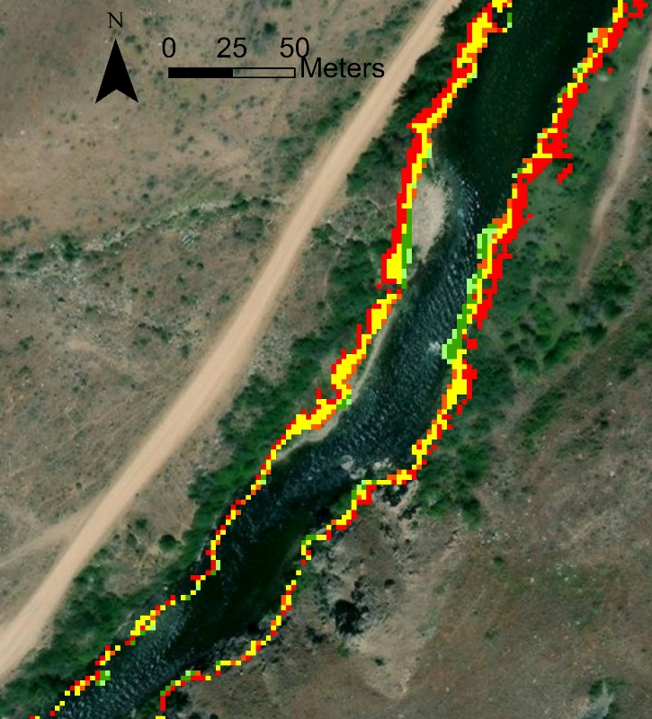

Combine Information into Failure Maps
Very narrow reach (total floodplain area ~9,000 m²)
Average year
42% of floodplain fails all parameters (red area)
51% of floodplain is available for restoration (yellow and orange areas)
7% of floodplain has recruitment success (dark green area)
Wet year
3% of floodplain fails all parameters (red area)
62% of floodplain is available for restoration (yellow and orange areas)
35% of floodplain has recruitment success (dark green area)
Regeneration limited by total floodplain area (~3,000 m²)
Ave Year
Wet Year
Notes:
The model combines that information to quantify the failure parameters in each floodplain
Additionally, it creates failure maps to show why each 2-m model cell fails to recruit

Slide 27
Recruitment mechanisms over varying floodplain widths
Percent successful area actually decreases with increasing floodplain width
Larger floodplains are less efficient than narrow ones, even if overall greater recruitment occurs in large floodplains

Slide 28
Recruitment mechanisms over varying floodplain widths
Recruitment increases in wet years, but still disappointing results…
Shear stress single most limiting factor
Wet years have more potential for restoration
Notes:
Combining the model results

Slide 29
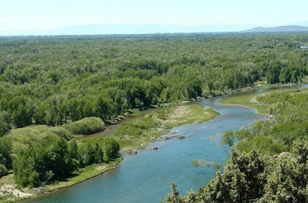
Western Riparian Forests – cottonwoods and willows
Riparian forests account for <1 % western U.S. landscape (Knopf, 1988; Braatne, 1996; Fierke and Kauffman, 2005; Brauderick et al., 2009; Tal and Paola, 2010)
Riparian forests:
Increases physical channel complexity
Input of large wood (>10 ft)
Stabilize streambanks and reduce fine sediment inputs
Vegetation drag creates hydraulic refugia during floods
Shade channel
Seasonal nutrient inputs
Critical component of Bull Trout habitat
Notes:
In general, riparian forests have limited spatial extents, but have outsized role in terrestrial and aquatic ecosystem function
For example, riparian forests make up <1% of the landscape but support more bird species than all other habitat types combined.
They also provide myriad benefits to the aquatic ecosystem that make them a critical part of BT habitat and the trophic levels that support them

Slide 30
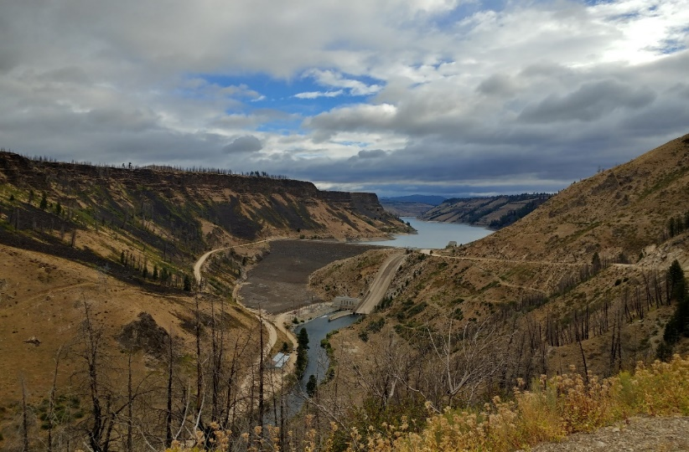
Riparian Forests Below Dams: limited floods and sediment supply
Stable river corridors below dams do not have the necessary disturbance regime (Gutowsky, 2000; Dykaar and Wigington, 2000)
  Homogenized forest age
  Older trees shade out new seedlings
  Shade tolerant understory forms (e.g., reed canary grass, tamarisk)
Ultimate collapse of western riparian forest ecosystems in managed rivers? (Friedman and Lee, 2002)
  Can floods improve forest regeneration processes?
Notes:
Because dams reduce downstream floods and cutoff sediment supply to D/S systems, there is no longer a disturbance regime to support pioneer species like cottonwoods
From a management perspective, can we leverage natural processes of floods and wildfire to improve forest regeneration below dams?

Slide 31
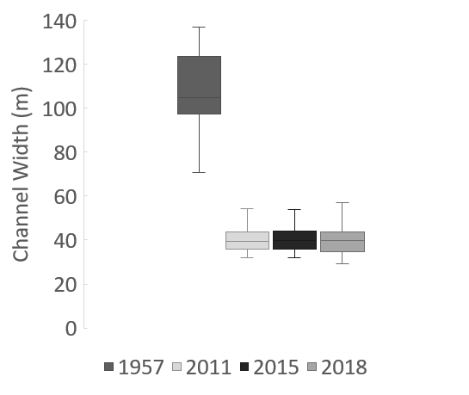
Dam cuts off floods and sediment supply
62% reduction in channel width
Bars colonized with vegetation
Existing forest canopy shades out seedlings
No seedling habitat available
Notes:
Quantify these changes we use channel width as a surrogate for channel dynamics
Reduced sexual reproduction of riparian forest

Slide 32
Disturbance Experiment in SF Boise River:
Riparian Forest Regeneration
Elk Fire of 2013
  First big disturbance to existing riparian communities since 1950s
  Tributary debris flows introduced sediment pulses to the river
High flows of 2017
  50-year flood event
  Provided sediment redistribution
Note: Riparian plants are recruited in pulses during system perturbations (Rood and Mahoney, 1991)
Notes:
Two recent events provided a unique opportunity to evaluate riparian forest regeneration in a managed river system

Slide 33
Riparian Forest Fire
Disturbance and sediment supply

Slide 34
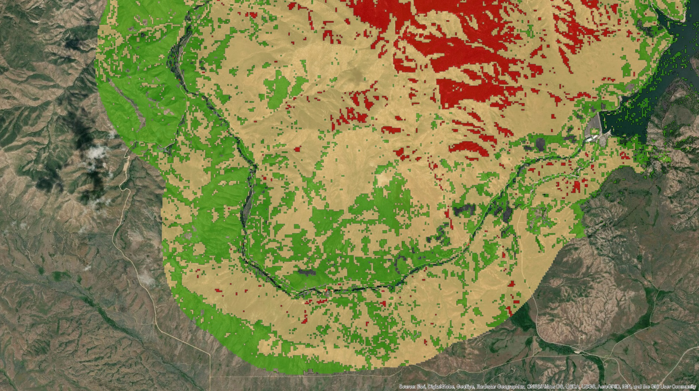
Burn Severity – August 2013 Elk Fire
Notes:
Disturbance over 23 km of river

Slide 35
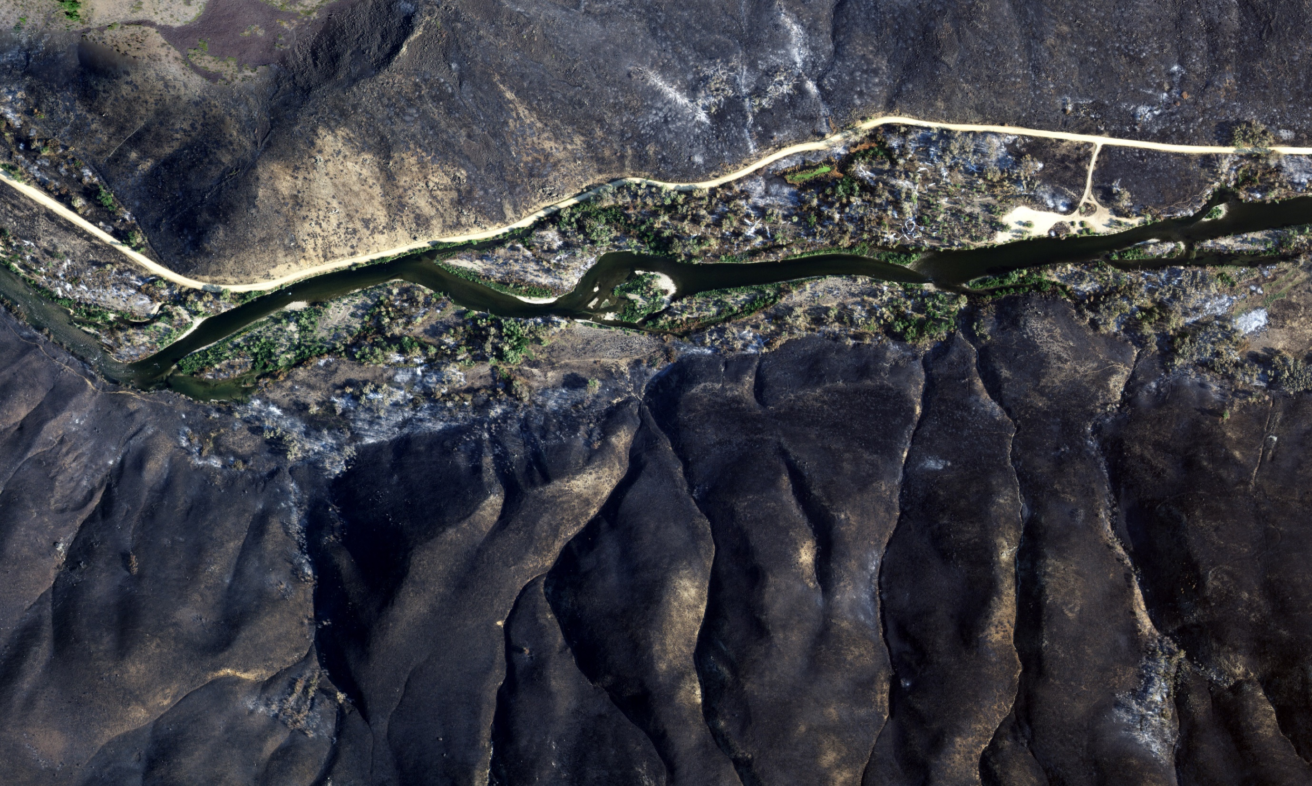
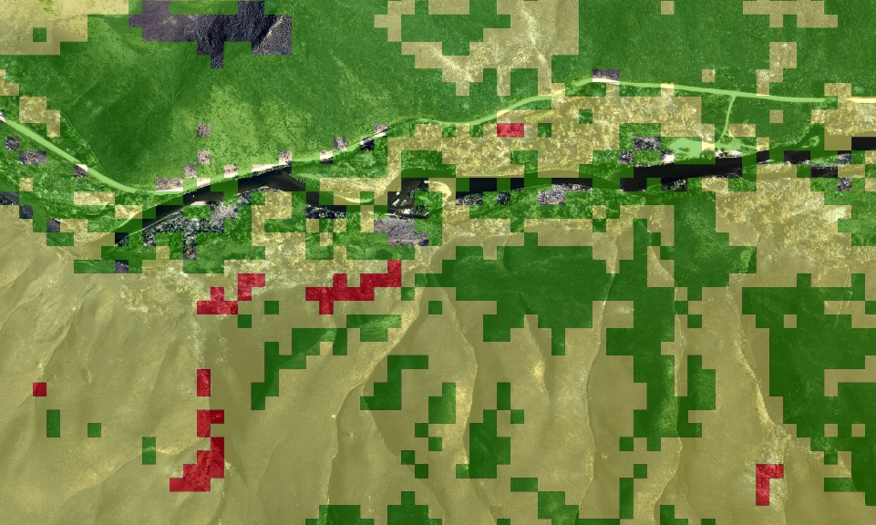
Notes:
August 2013
Variable burn intensity across floodplain – very low to moderate
No high severity burn near the channel
Can burn severity provide a beneficial disturbance for forest regeneration?

Slide 36
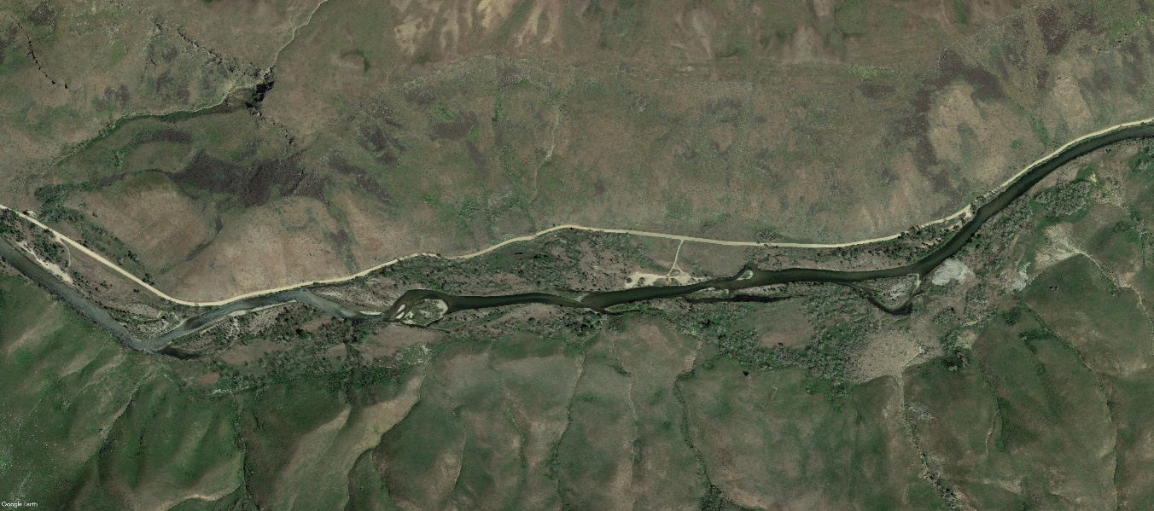
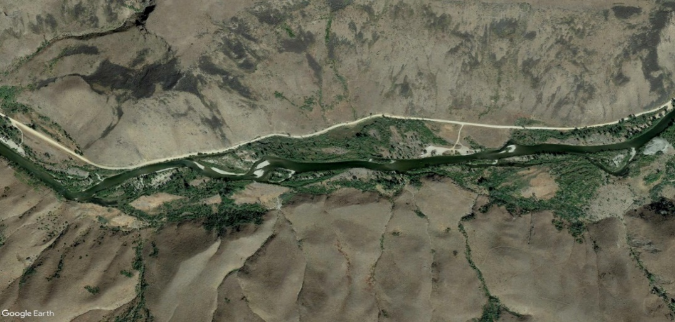
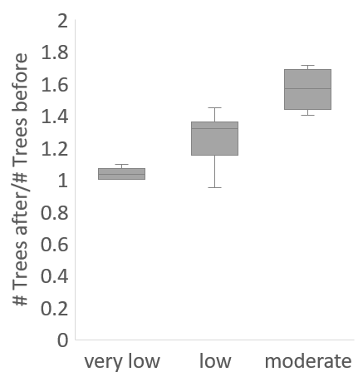
Post-fire clonal regeneration in floodplain
2011
2018
Burn Severity
Notes:
tree counts in 200 m transects from aerial photos that were ground-truthed, compared pre and post burn
Tree density increased with burn severity, up to 60% more for moderate burn severity
Great, the forest is recovering! However, this increase is from clonal sprouts from the roots
Black cottonwoods have high sprouting success after a burn
In fact, there were no floodplain seedlings related to the fire at all

Slide 37
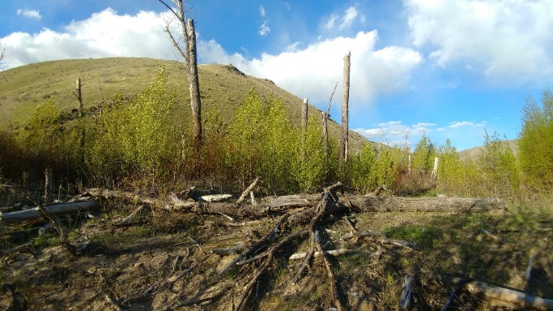
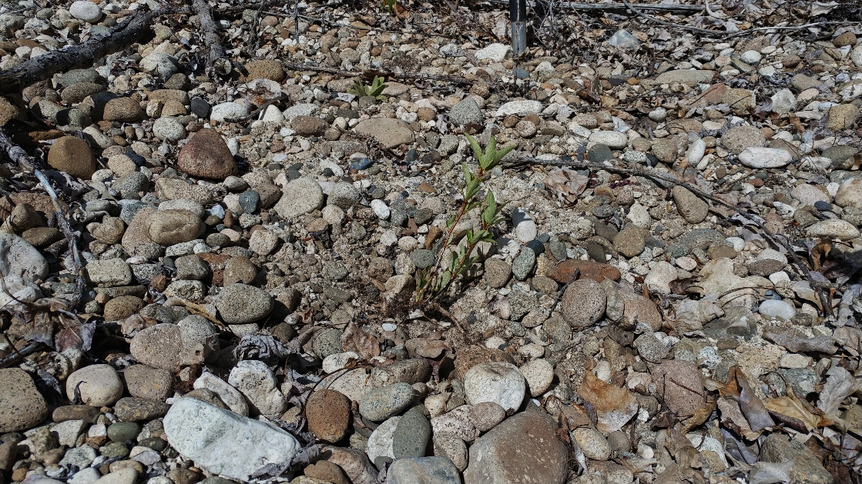
Root sprouts were principal regeneration process that increased tree density on floodplain
More trees, but same genetic stock!
Notes:
Old tree is topkilled and root sprouts come out radially
More trees after the wildfire, but no change to genetic diversity in forest

Slide 38
Inundation Area – Average Year 2016
Notes:
Our hydraulic model helps visualize why no successful seedlings
Blue outline is irrigation flow
Magenta shows extent of peak inundation
No seed dispersal onto floodplain

Slide 39
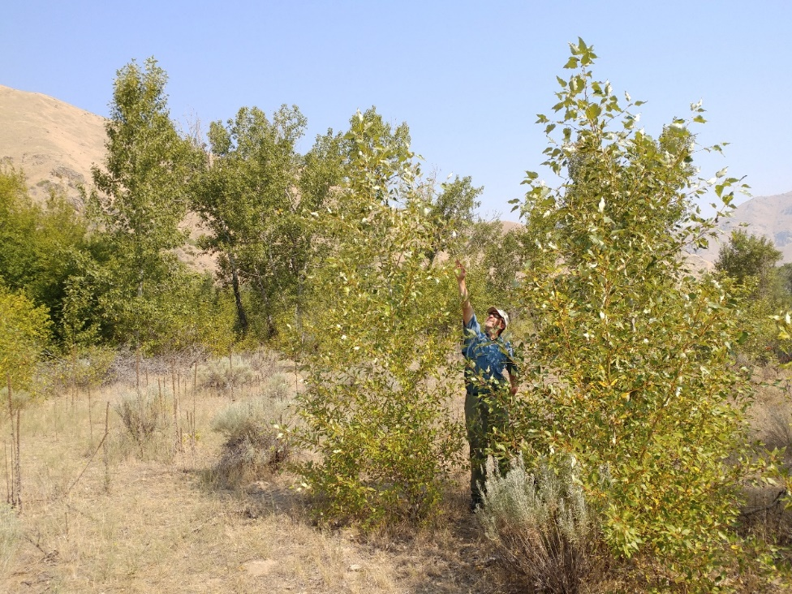
No seedling recruitment on floodplain
Clonal sprouting only
Overhead root sprouts in 2018
Debris
Flows
Fire
Contained
Range of bankfull discharge
Notes:
Three years before overbank floods occurred to disperse seeds
By 2017, root sprouts had already occupied much of the good habitat

Slide 40
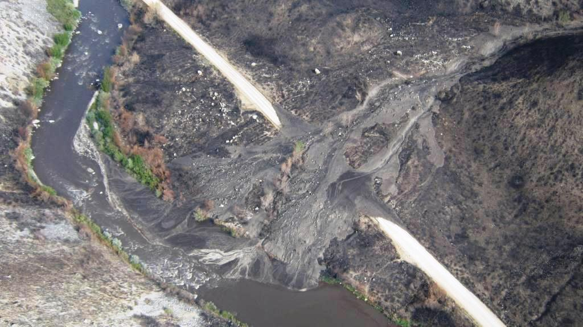
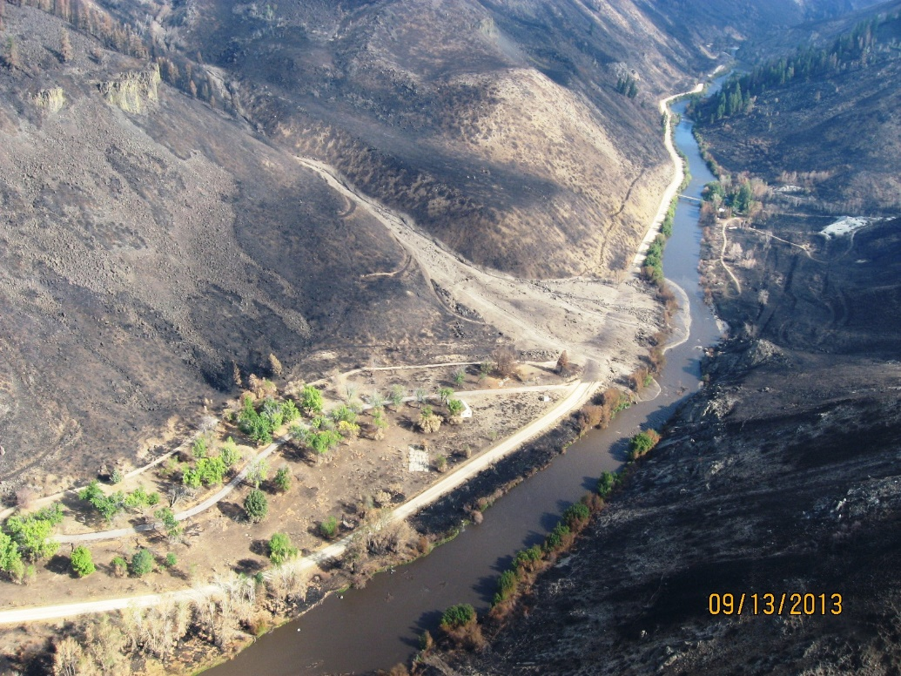
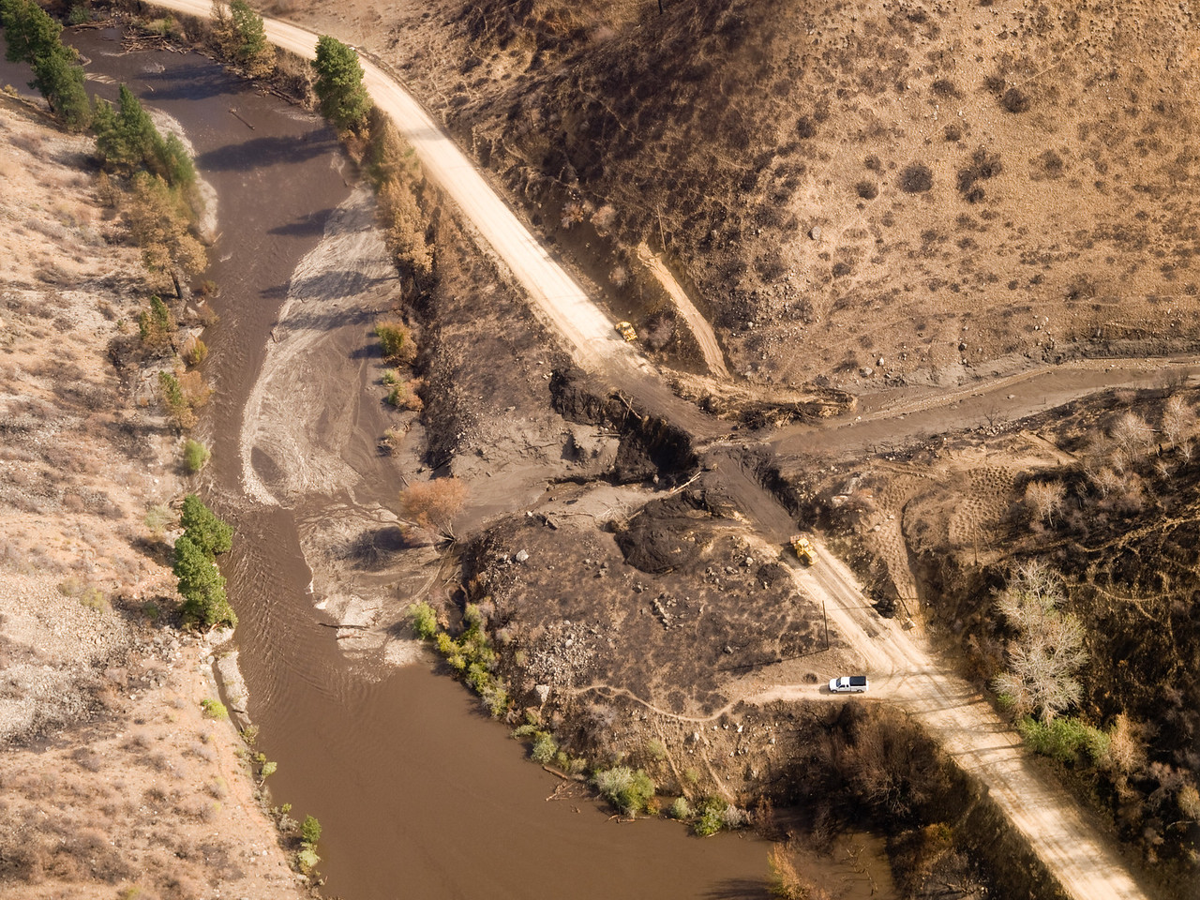
Another wildfire consequence:
Sediment inputs from debris flows
Notes:
Debris fans provide limited direct benefits for seedling habitat
Load the channel with a pulse of fine and coarse sediments that was not present before

Slide 41
Flood
Morphologic change and sediment redistribution

Slide 42
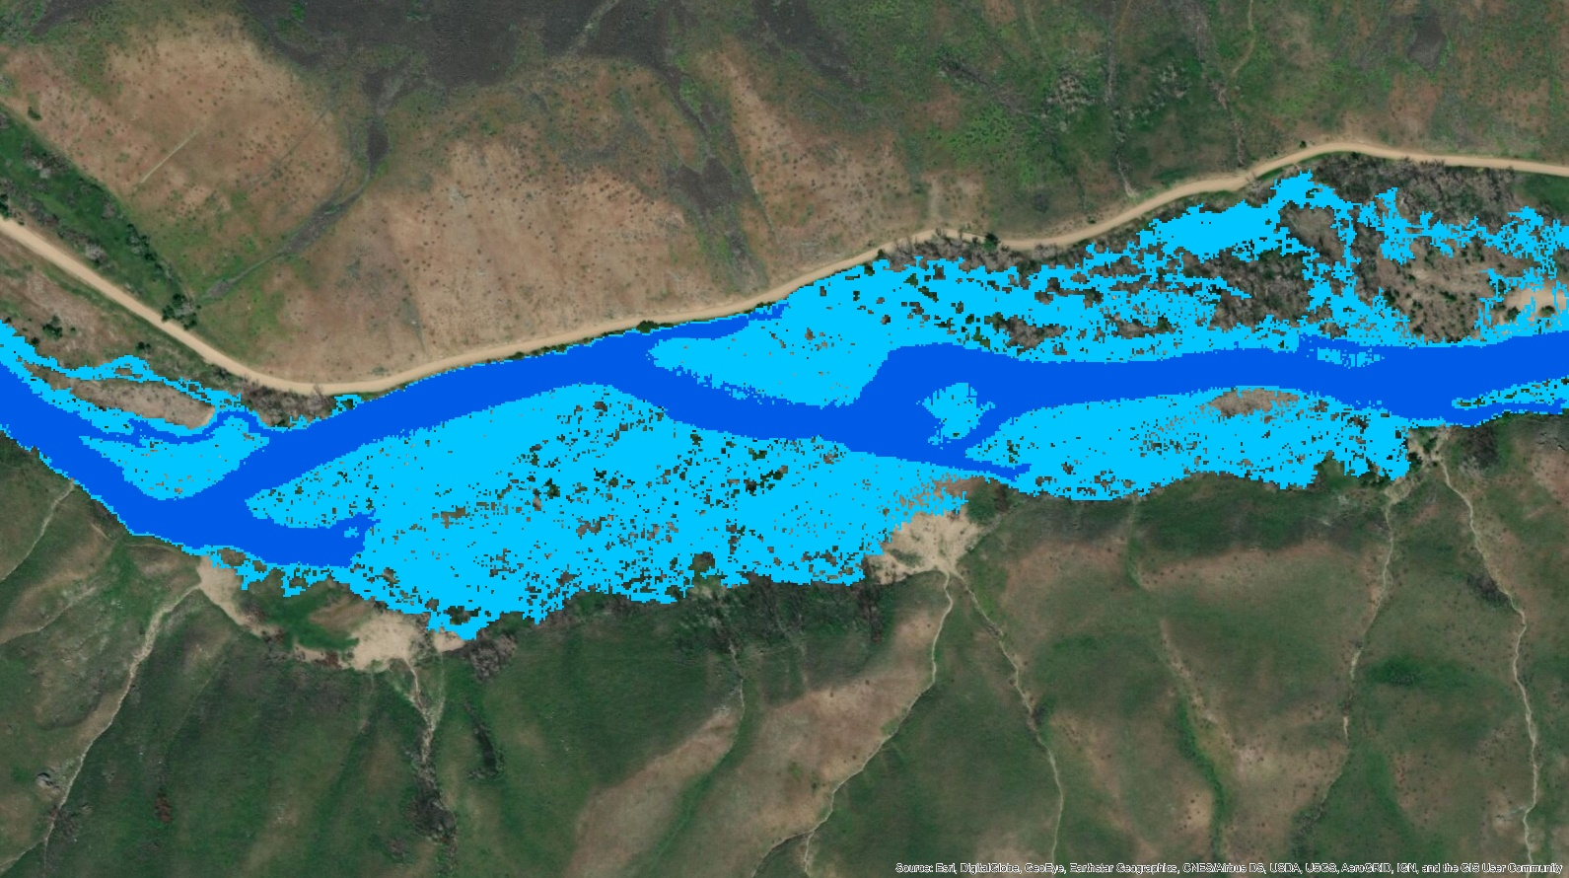
Inundation Area – Wet Year 2017 (50-year flood)
Notes:
Large sediment transport capacity in channel and inundation extent on FP
High seed dispersal

Slide 43
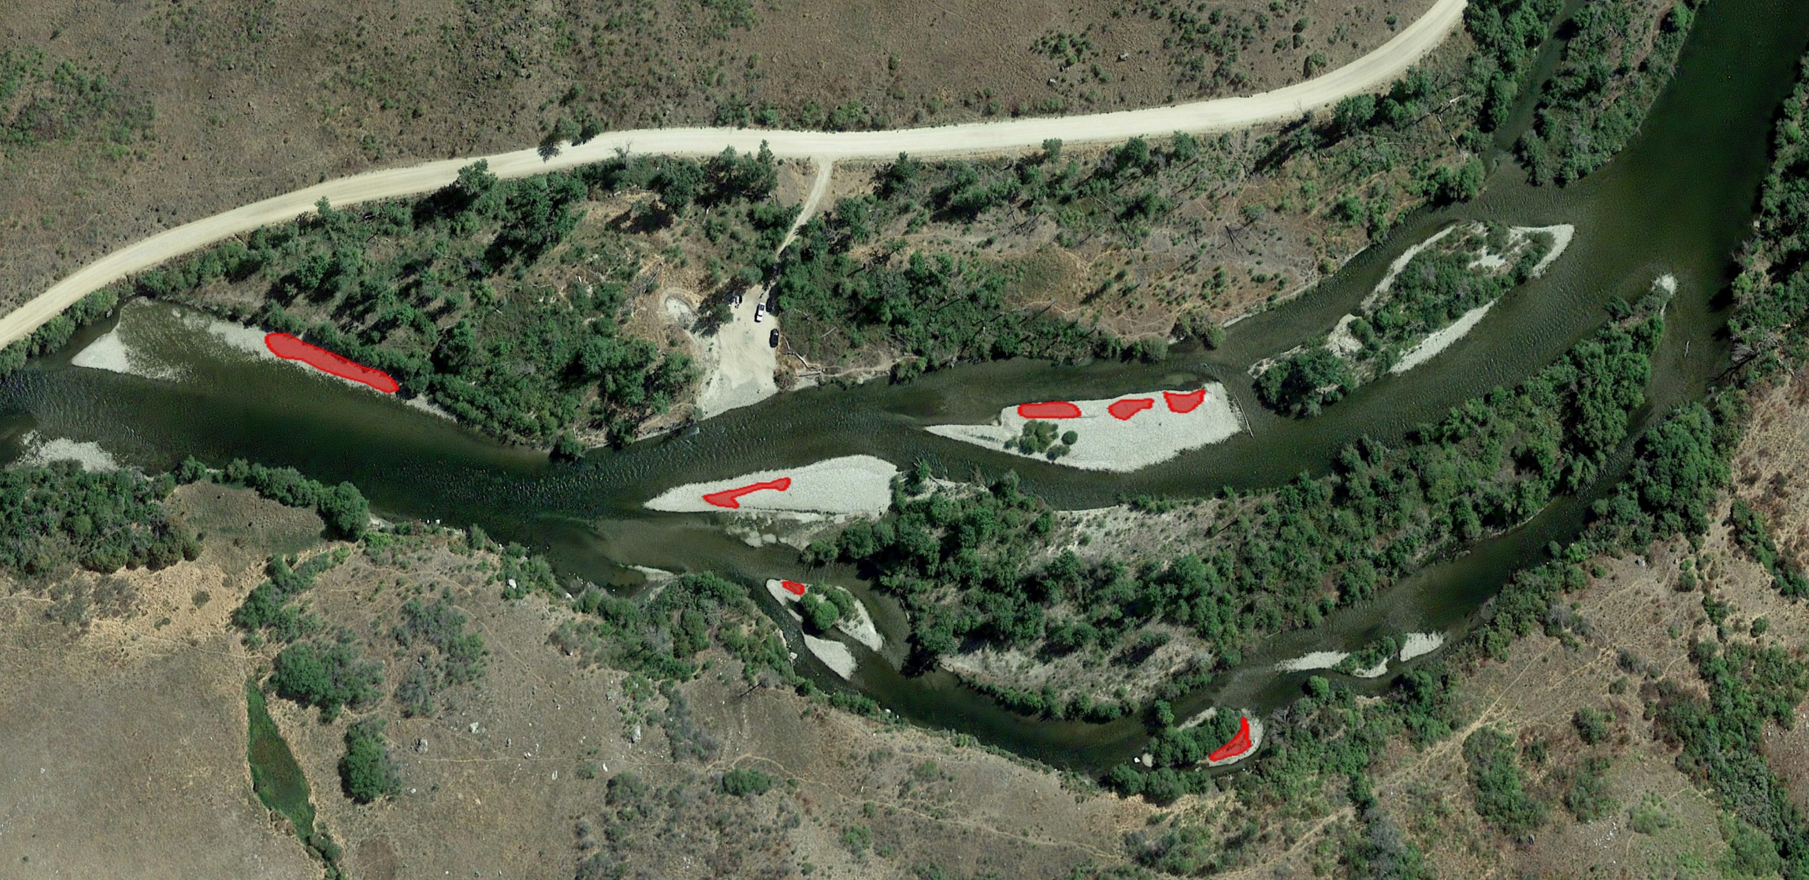

2017 flood redistributed sediment
N
50 m
Notes:
Deposition modified bars and created new islands in hydraulically sheltered areas downstream of existing vegetation
Created bare sediment not seen since the 50s and 60s
Red patches are surveyed seedling patches

Slide 44
Where does seedling recruitment occur?
Ave hydrologic year
  100% recruitment in channel b/c no floodplain inundation
  Low elevation bars and streambanks
  Likely destroyed in subsequent year
Wet hydrologic year
  Limited floodplain success as sprouts shade out seedlings
  Recruitment on new sediment patches
  Higher elevation along banks and bars
Notes:
Recruitment depends on hydrologic conditions

Slide 45
Successful Riparian Recruitment Processes
Depositional areas supported an order of magnitude greater seedling recruitment area
Erosional areas provided limited habitat
Fine sediment was present in most depositional areas
Notes:
Relate recruitment to processes, cluster surveyed seedling patches by dep and eros
Erosion areas are cut banks and eroded floodplain surfaces

Slide 46
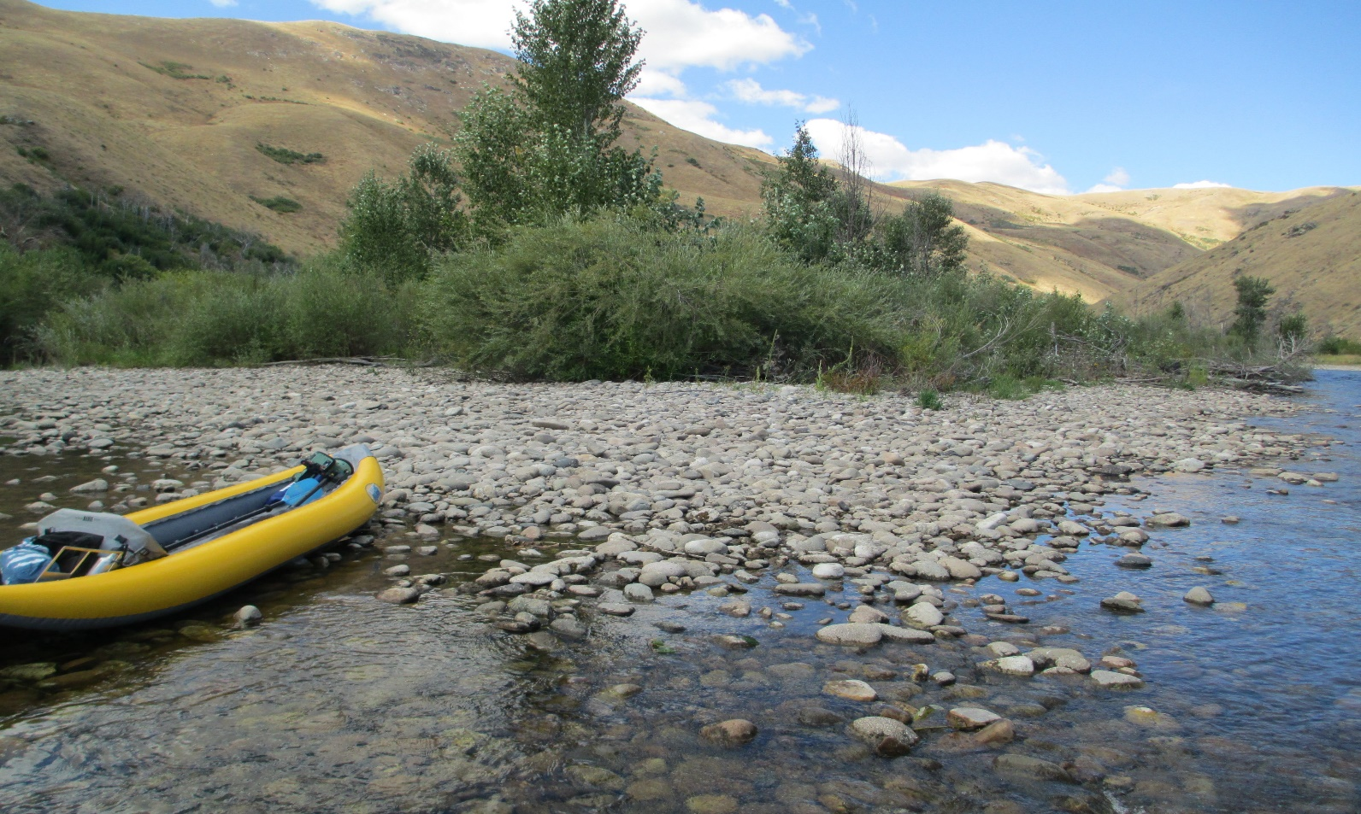
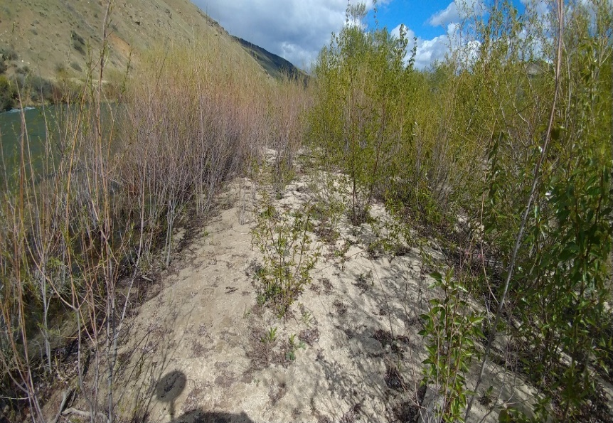
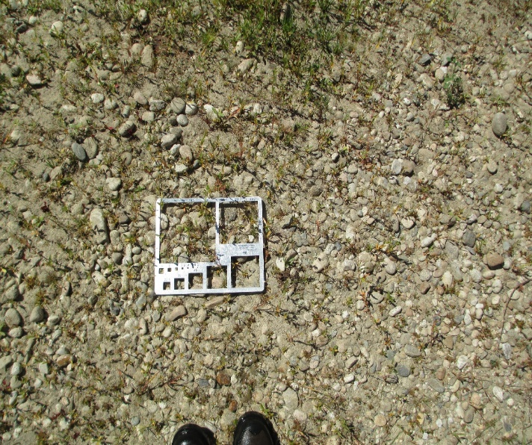
Fine sediment is important!
Notes:
Depositional areas provide fine sediment in an otherwise sediment limited system
Coarse sediment had significantly less seedling success (top)
Fine sediment was critical for seedlings (bottom)

Slide 47
Modeled sediment transport 2013-2018
Debris
Flows
Fire
Contained
Range of bankfull discharge
Notes:
Link these field observations at the larger system scale → used a 1D morphodynamic model
model used the post-burn flow sequence 2013-2018

Slide 48
Cumulative bed change: 2013-2018
Sediment supply and deposition processes are critical for seedling success!
Notes:
Dashed boxes show channel confinement by the canyon
Blue lines identify reaches with secondary channels
Red patches are recruitment in depositional areas
Green patches are recruitment in erosional areas
Over 15 km of river, seedling recruitment occurs mostly in depositional areas
Therefore, in rivers below dams pulses of mixed sediments are important for forest regeneration

Slide 49
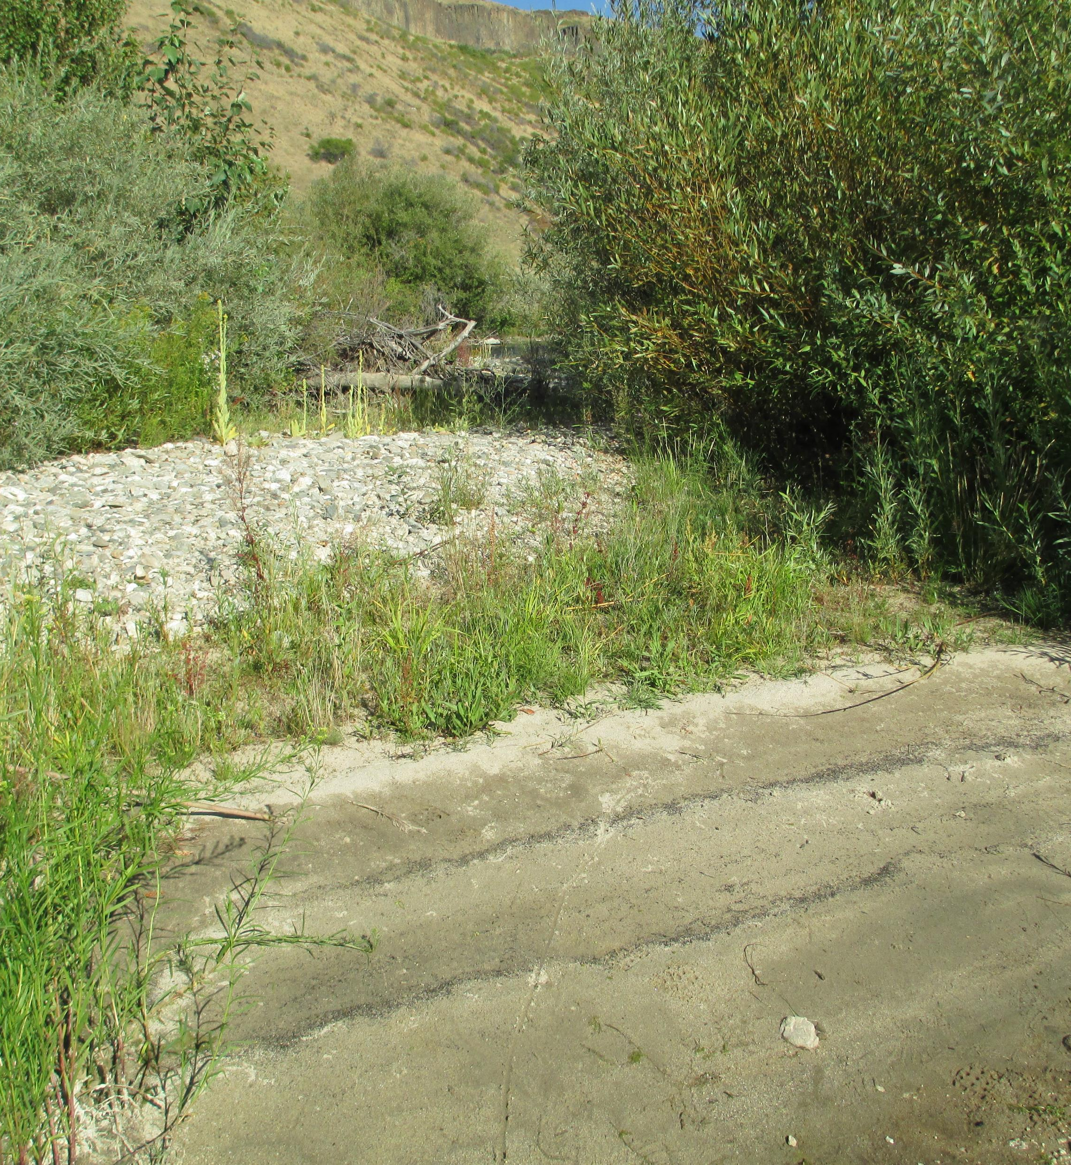
Impacts of fire and flood on riparian forest regeneration
Clonal regeneration can increase tree density, but not genetic diversity
Disturbances support seedling recruitment processes for genetic diversity and long-term forest resilience
In supply-limited systems below dams, fine sediment pulses and resultant deposition can increase riparian forest regeneration processes
  Contrary to most fisheries management!
Notes:
From a process perspective, post-fire disturbance is beneficial for riparian habitat creation
Without sufficient disturbance clonal regeneration will dominate and increase tree density but not genetic diversity
Dam operations can be used to create beneficial disturbances to support seedling recruitment and genetic diversity
Additionally, in sediment supply-limited rivers below dams, forest regeneration was increased by a pulse of fine sediment
Therefore, as always, there is a management tradeoff as fine sediment addition is usually contradictory to most fisheries management strategies

Slide 50
Managing post-fire riparian forest regeneration
Seedling recruitment is a balance of disturbances: flood (dam releases) and wildfire (burn severity)
Low burn severity may require higher flood peaks
High severity only requires overbank flows - get the floodplain wet
As time progresses, the magnitude of operational disturbance required will increase
Questions to Andy Tranmer (andyt@uidaho.edu)
Study details can be found here:
Forest Ecology and Management https://doi.org/10.1016/j.foreco.2020.118513
Notes:
From a management perspective, dam operations can be manipulated to increase riparian habitat dynamics after a wildfire
It is hard to justify increasing the flows after a burn for intentional disturbances, but may be necessary for pioneer forest species
Use this conceptual model to understand the processes

Slide 51
Access to Data and Publications
Updating our webpage with publications list
  https://www.uidaho.edu/engr/research/cer
  https://sites.google.com/site/emyager/home
Some publications are publicly available, others you can request from us via email
Notes:
Academics are horrible at this – journal policies prohibit sharing

Slide 52




2017 Korea Experiments

Slide 53

Vegetation increased channel complexity 25%
Notes:
Channel scale - Vegetation changes channel from depositional to erosional
Patch scale – Vegetation increases topographic variance of the bed by 25% as a metric of channel complexity
Increased deposition in patch
Increased erosion in channels

Slide 54
Environmental flows for vegetation management
Riparian seedling recruitment models account for hydraulics
  Sufficient disturbance
  Proper peak timing
  Slow recession rate
  Distance to groundwater
  Few submerged flood days
Sediment supply also critical!
Benjankar et al., 2020

Slide 55
Riparian fire effects – beneficial or detrimental?
Stand age and water content are primary controls of riparian burn intensity (Gom and Rood, 1999)
  Older stands have more deadwood → higher burn intensity
  Vegetation water content is determined by timing of fire (summer vs fall) and dam operations
Black cottonwood more successful at regen via sprouting than other poplar species
  Clonal sprouting resets to uniform stand age
  Sprout shoots outcompete seedling growth rates 3 to 1
  No genetic changes to community

Slide 56

Anderson Dam closure: 1950

Slide 57


Role of Fire

Slide 58


Low Intensity - coppice and root sprouting

Slide 59



Post-fire clonal regeneration in floodplain
a)
More trees – same genetic diversity!
b)
c)
d)
Burn Severity
Notes:
tree counts over 200 m transects from aerial photos that were ground-truthed with 2011-2018
Tree density increased with burn severity
Black cottonwoods have high sprouting success after a burn
More trees after the wildfire, but no change to genetic diversity in forest

Slide 60
Reservoir Operations

Slide 61

Riparian Vegetation Field Survey 2018
Successful 1 Yr Seedlings were spatially limited near channel
No cottonwoods were successful, only willows
  Fast drawdown of hydrograph
  Existing vegetation was not removed
  No fine sediment for seedbed
  New islands were most successful recruitment areas
Hydraulics alone may be insufficient for seedling recruitment

Slide 62
Reed Canary Grass
Grass mat covers limit recruitment at <15% cover.
balance the magnitude of dam releases (flood disturbance) and wildfire severity (burn severity) to attain the appropriate geomorphic disturbance required for successful seedling recruitment (envelope between dashed lines)
Fierke and Kauffman, 2005

Slide 63

a)
b)
c)
d)

Slide 64
Disturbance Regime from Tree Age
Tree Age = Growth Factor x Diameter at Breast Height
Cottonwood Count: 153
Willow Count: 30
From work of Dave Blew

Slide 65

Questions?

