Slide 1
South Fork Boise River Collaborative Meeting Federally Listed Species
Ciara Cusack
Fish and Wildlife Biologist
US Fish and Wildlife Service

Slide 2
Endangered Species Act
Section 7(a). Interagency Cooperation –Federal Agency Actions and Consultations
All other Federal agencies shall, in consultation with and with the assistance of the Secretary, utilize their authorities in furtherance of the purposes of this Act by carrying out programs for the conservation of endangered species and threatened species listed.
Each Federal agency shall, in consultation with and with the assistance of the Secretary, ensure that any action authorized, funded, or carried out by such agency is not likely to jeopardize the continued existence of any endangered species or threatened species or result in the destruction or adverse modification of habitat of such species.

Slide 3
Preliminary Potential Species (Dependent on Final Action Area and any future updates)
IPaC:
Information for Planning and Consultation- Species List
Action Area
All areas to be affected directly or indirectly by the Federal action
Species
Canada Lynx (Lynx canadensis), Threatened
North American Wolverine (Gulo gulo luscus), Proposed Threatened
Monarch Butterfly (Danus plexippus), Candidate
Whitebark Pine (Pinus albicalus), Threatened
Critical Habitats
Bull Trout Critical Habitat (Final)
Bull Trout (Salvelinus confluentus), Threatened

Slide 4
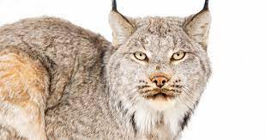
Canada Lynx
Species Presence
Trinity Lynx Analysis Unit (LAU)
No recent detections
Species Updates
Draft Recovery Plan in progress

Slide 5
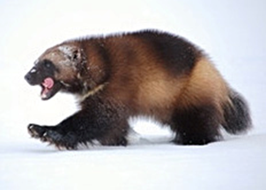
North American Wolverine
Species Presence
Potential to occur within the Action Area depending on project scale
Species Updates
Species Status Assessment Addendum Completed Sept 28, 2023
Listing decision Nov 2023

Slide 6
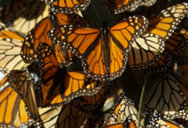
Monarch Butterfly
Species Presence
Potential to occur within the action area depending on project scale
Milkweed has been observed
Species Updates
Proposed listing/proposed CH on national listing workplan to be completed FY 2024.
Conservation recommendations

Slide 7
Whitebark Pine
Species Presence
Potential to occur within the Action Area depending on project scale
Species Updates
Final rule went into effect on January 17, 2023

Slide 8
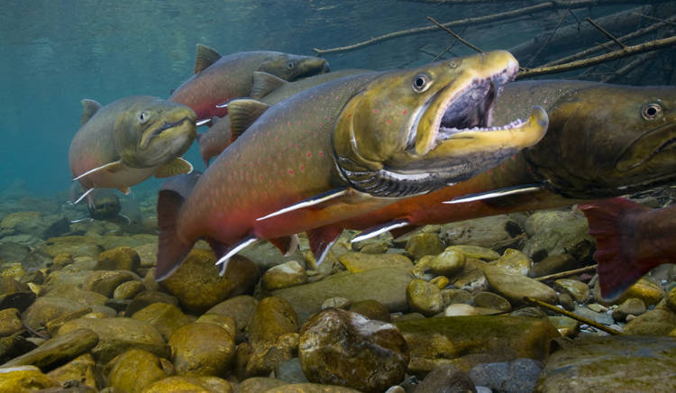
Bull Trout
Species Presence
South Fork Boise River
Throughout entire reach
Tributaries
Where access and adequate habitat/stream temperatures exist
Bull Trout Critical Habitat
South Fork Boise River
Foraging, migratory and overwintering habitat
Rattlesnake Creek and Little Rattlesnake Creek
Spawning and Rearing
Species Updates
Species Status Assessment (SSA) is in progress

Slide 9
Bull Trout Critical Habitat
Springs, seeps, groundwater sources, and subsurface water connectivity.
Migratory habitats with minimal barriers.
An abundant food base.
Complex river, stream, lake, reservoir, and marine shoreline aquatic environments and processes with features such as large wood, side channels, pools, undercut banks and substrates, to provide a variety of depths, gradients, velocities, and structure.
Water temperatures ranging from 2 to 15 °C (36 to 59 °F), with adequate thermal refugia available for temperatures at the upper end of this range.
Substrates of sufficient amount, size, and composition to ensure success of egg and embryo overwinter survival, fry emergence, and young-of-the-year and juvenile survival.
A natural hydrograph, including peak, high, low, and base flows within historic and seasonal ranges or, if flows are controlled, they minimize departures from a natural hydrograph.
Sufficient water quality and quantity such that normal reproduction, growth, and survival are not inhibited.
Few or no nonnative predatory species present.

Slide 10
Other Species to consider
Yellow-Billed Cuckoo (Coccyzus americanus), threatened
While they aren't consistently found in the corridor, there have been some detections in the past.
Bald and Golden Eagles
Migratory Birds
Native Species

Slide 11
Questions?
Contact Information:
Idaho Fish and Wildlife Office
ciara_cusack@fws.gov

